Slide 1
7-Jul 2018
Contact: sxiong@clarku.edu
This slide shows the workflow and test result of “filter_rst.py”on planet scenes.
1. Max and min image is created from blue, green, red, and near infrared bands as b1,b2,b3,b4
2. Apply 7x7 max filter on max image. This is intend to get rid of the small dark areas, which are smaller or thinner than 7x7 pixels, e.g., burned fields, canals, or asphalt road. This will also lead shadows lost their edges. Apply 7x7 min filter on min image. This is intend to get rid of the small roofs which are smaller than 7x7 pixels. This will also lead the clouds lost their edges.
3. Extract cloud, shadow plus water, and land.
Cloud is extracted from min image (7x7 filtered min image), where reflectance > threshold
Shadow is extracted from max image (7x7 filtered max image), where reflectance < threshold
Land area is extracted using >1000 in NIR band (b4).
4. The shadow is further masked by land area, thus excludes the water.
Test images:
on next two pages, from left to right, from up to bottom.
1. "20180228_095050_102f_3B_AnalyticMS_SR_",
2. "20180228_095154_1025_3B_AnalyticMS_SR_",
3. "20180303_095157_1014_3B_AnalyticMS_SR_",
4. "20180303_105144_1050_3B_AnalyticMS_SR_",
5. "20180306_095153_0f52_3B_AnalyticMS_SR_",
6. "20180310_095138_102e_3B_AnalyticMS_SR_",
7. "8. "20180314_095225_1042_3B_AnalyticMS_SR_",
8. "20180314_095225_1042_3B_AnalyticMS_SR_win_",
9. "20180314_095229_1042_3B_AnalyticMS_SR_"

Slide 2
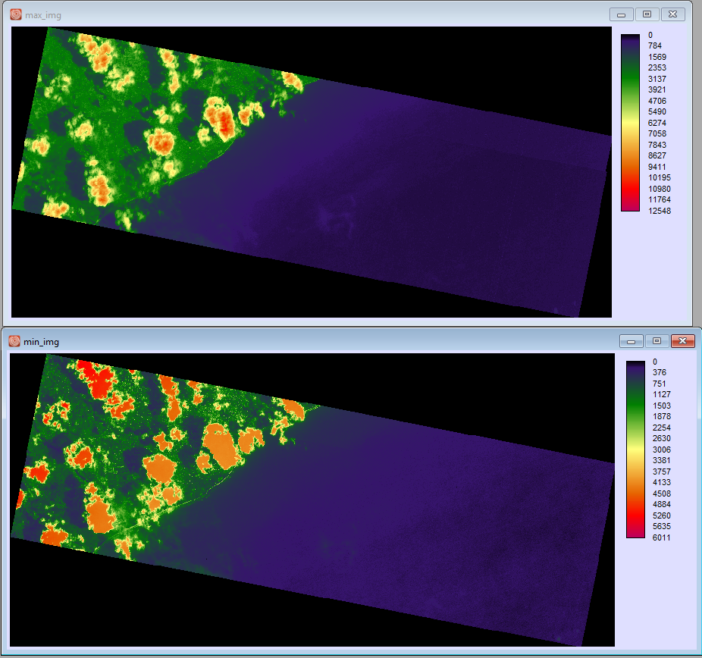
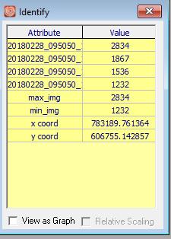
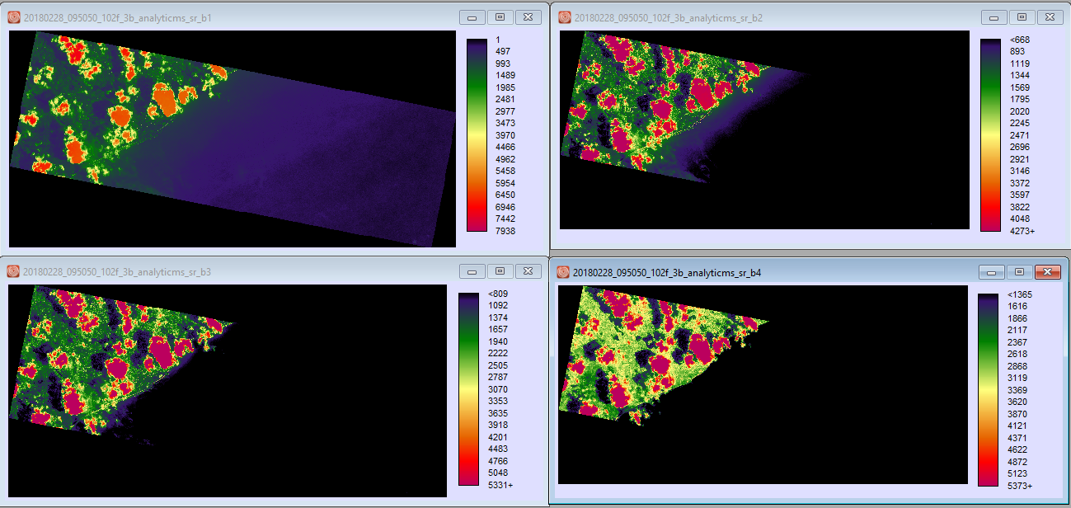
Max and min image
Original b1,b2,b3,b4
Values of b1,b2,b3,b4, max, min of a single pixel
Max and min image (the display palette makes the min image looks bright)

Slide 3
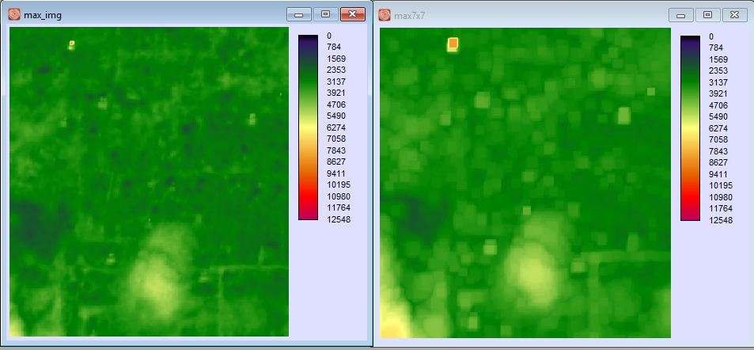
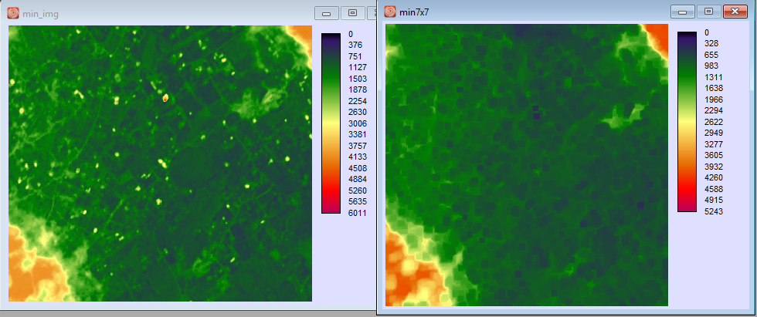
Max and min image vs. max7x7 and min 7x7
Max(left) and Max7x7(right)
Min(left) and Min7x7(right)

Slide 4
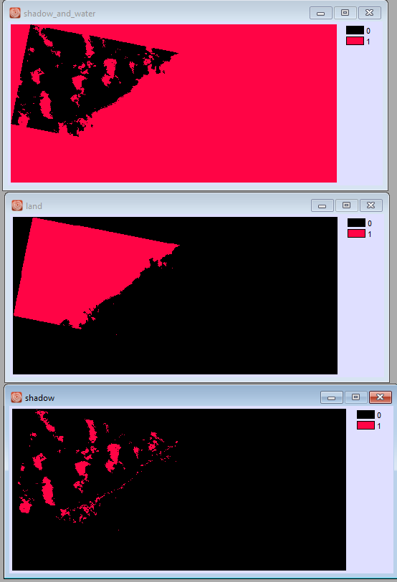
Shadow plus water, land, and shadow
Shadow plus water (top), land (meddle) and shadow(bottom)

Slide 5
Cloud and shadow
The following slides show cloud and shadow together, using different threshold for cloud.

Slide 6
Test images

Slide 7
1 = Shadow
2 = Cloud
Cloud > 4000
Shadow < 2000

Slide 8
1 = Shadow
2 = Cloud
Cloud > 3800
Shadow < 2000

Slide 9
1 = Shadow
2 = Cloud
Cloud > 3150
Shadow < 2000

Slide 10
1 = Shadow
2 = Cloud
Cloud > 3150
Shadow < 2000

Slide 11
Conclusion:
Use 4000 will under estimate clouds, as well as use 3800. We kept lower the threshold for cloud until 3150, and more cloud get picked up without picked up trees, urban, or something else.
There is a threshold works for shadows in all scene, that is < 2000.
The algorithm may pick up large bright roof (larger than 7x7) as cloud, and the bright water as shadow.

